Slide 1
Whirlpool Amana Fridge Gap & Flush and Badging Turnkey System
Customer Kick Off
06/16/2016

Slide 2
Meeting Agenda
Purpose
Project Scope Review
System Layout and Process
Quality Check Measurements
Installation Timeline
Roles and Responsibilities Review
Q&A Session

Slide 3
Purpose
Field Check Design and System Layout
Kick Off Project with Whirlpool Amana
Plan Next Steps

Slide 4
Project Scope Review
Perceptron’s Turnkey Solution
Station 1 & 2 – MSS – Perceptron Content – Door Alignment / Confirmation Check / Gap & Flush
6 Models – 3 per station
16 Checkpoints total
Door Alignment – 1 Checkpoint
Door Confirmation – 1 Checkpoint
Gap and Flush – 14 Checkpoints across all models
4 Relationships
Station 3 – Badging (Located in conjunction with Perceptron Station 2)
2 Badging locations
12-14 Badge variation total

Slide 5
Project Scope Review
Amana Will Provide:
Access to the Stations
Refrigerators in Stations - all models
Necessary CAD and Tooling information
Parts/Pallets repeatedly located on conveyor within +/- 0.5 inches
All plastic removed from measurement locations
Resources to mount tunnel structures

Slide 6
System Layout and Process
System Layout and Process Overview

Slide 7
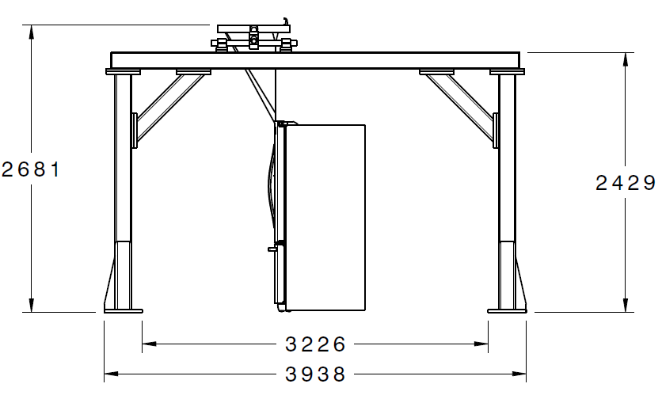
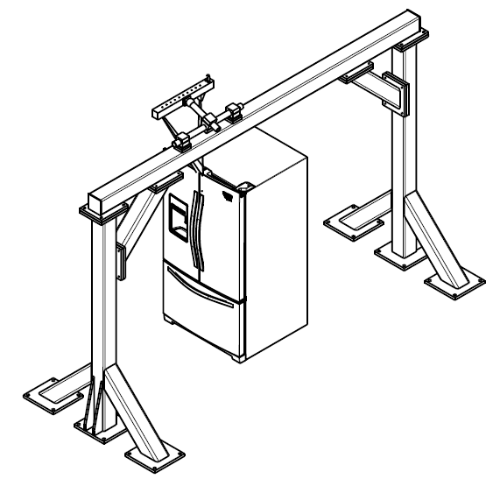
System Layout and Process
Perceptron Process Check Station Layout

Slide 8
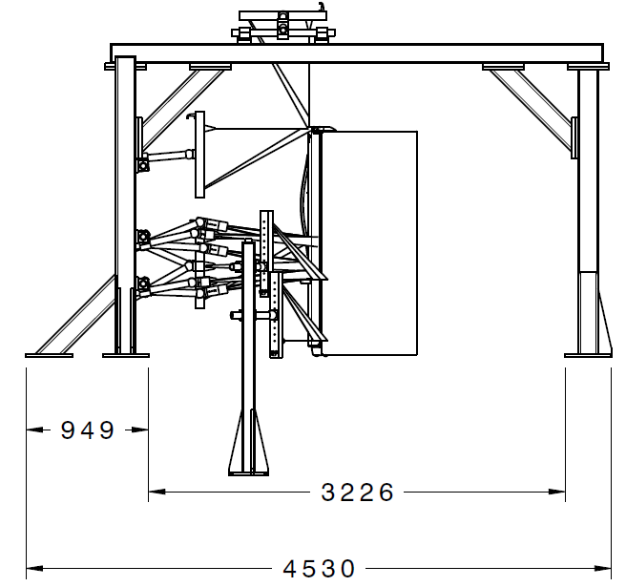
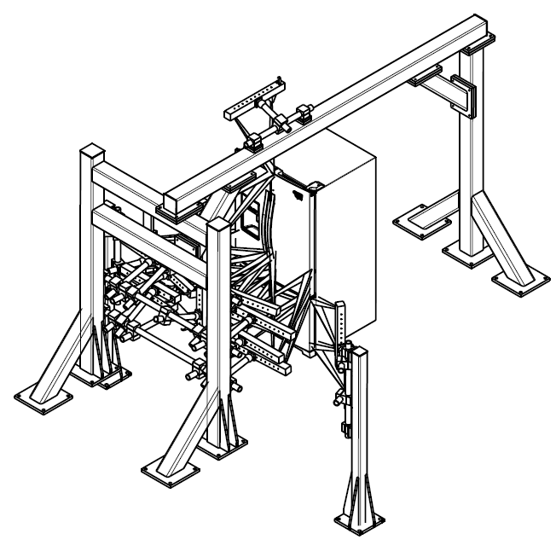
System Layout and Process
Perceptron Quality Check Station Layout

Slide 9
System Layout and Process
Perceptron Quality Check Station Iso View

Slide 10
System Layout and Process
Perceptron Cabinet Footprint

Slide 11
System Layout and Process
USS Cabinet Footprint

Slide 12
System Layout and Process
System Process
Barcode reader scans barcode sticker on fridge
PLC determines model, color, and ID number
Part travels down conveyer
Part breaks trigger switch
Perceptron Station #1 (Process Check) measures door flushness
Perceptron sends flush in mm to PLC
PLC converts mm to turns for smart gun
PLC sends turns to smart gun
Part travels down conveyer
Operator uses smart gun to adjust door alignment
Part travels down conveyer
Part breaks trigger switch
Perceptron Station #2 (Quality Check) measures multiple part features
Perceptron sends quality bit alarm to PLC
PLC sends part quality status to Whirlpool database (if required)
Part is measured by badging system (USS)
Badging system sends PLC results

Slide 13
3 Door Refrigerator Base Model 26/29, 3x, Bella
Nomenclature
French_Door_Top
French_Door_Bottom
French_Drawer_LH_Outter_1
French_Drawer_LH_Inner_1
French_Drawer_RH_Outter_1
French_Drawer_RH_Inner_1
Not Shown
Top
Side_LH_Upper
Side_LH_Lower
Side_RH_Upper
Side_RH_Lower
1
2
3
4
6
5

Slide 14
4 Door Refrigerator Model Talladega
1
Nomenclature
French_Door_Top
French_Door_Bottom
French_Drawer_LH_Outter_2
French_Drawer_LH_Inner_2
French_Drawer_RH_Outter_2
French_Drawer_RH_Inner_2
Drawer_Drawer_LH_Outter
Drawer_Drawer_RH_Outter
Not Shown
Top
Side_LH_Upper
Side_LH_Lower
Side_RH_Upper
Side_RH_Lower
2
3
4
6
5
7
8

Slide 15
5 Door Refrigerator Model Cameo
1
Nomenclature
French_Door_Top
French_Door_Bottom
French_Drawer_LH_Outter_2
French_Drawer_LH_Inner_2
French_Drawer_RH_Outter_2
French_Drawer_RH_Inner_2
Drawer_Drawer_LH_Outter
Drawer_Drawer_LH_Inner
Drawer_Drawer_RH_Outter
Drawer_Drawer_RH_Inner
Not Shown
Top
Side_LH_Upper
Side_LH_Lower
Side_RH_Upper
Side_RH_Lower
2
3
4
6
5
7
8
10
9

Slide 16
Installation Timeline

Slide 17
Roles and Responsibilities
Proposal Reference

Slide 18
Q&A Session
Questions for Whirlpool

