Slide 1
Evaluation – September 2015
Minerva Plant Evaluation
September 21st – October 1st 2015

Slide 2
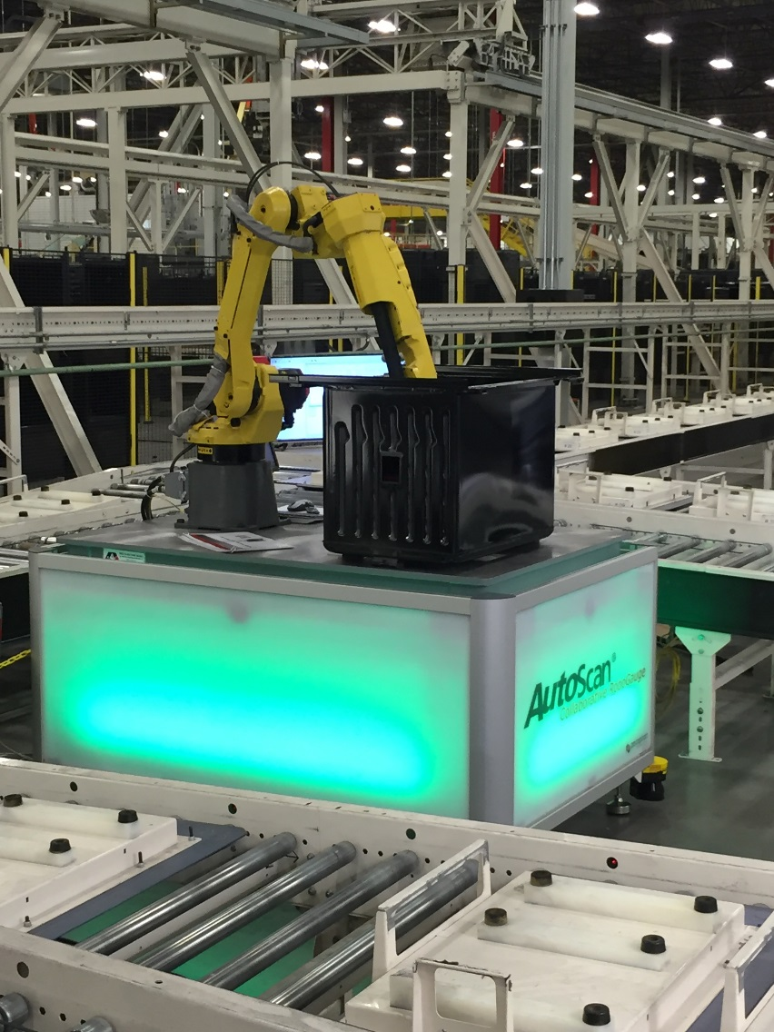
Objectives
Demonstration Objectives
Concept Design
Confirm features to measure
Confirm visual fixture scheme
Reference GD&T
Reference Plant CMM fixture scheme
Confirm all parts can be measured in plant environment
Black/Gray/Blue porcelain
Metal
Physical Setup
Determine where to locate system
Setup area scanners
Conduct Risk Assessment – Sundeep Jaganath
System Validation
Drift Check Results
CMM Correlation Results
Variation Reduction Analysis
Next Steps
General Notes
Proposed Solution

Slide 3
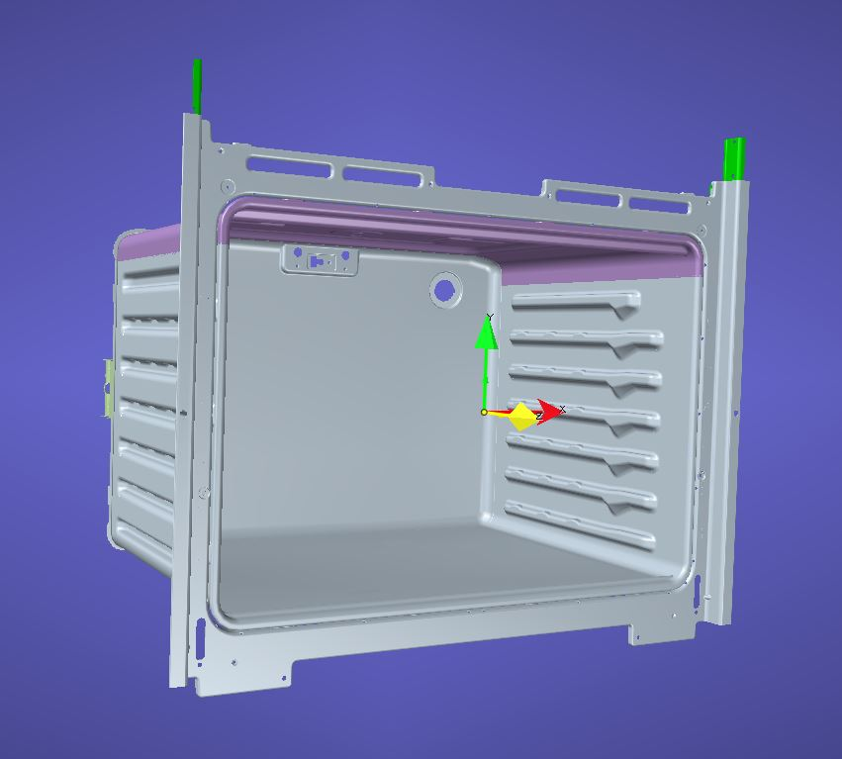
Concept Design: Overview
Details
Drift Check
Error Proofing
3 Measurement Locations
Model Measurement
30” Minerva Model
21 Checkpoints
Datum A (3)
Datum B (2)
Datum C (1)
Rail Width Positions
Rail 2 Left/Right Front (2)
Rail 2 Left/Right Middle (2)
Rail 2 Left/Right Rear (2)
Rail 5 Left/Right Front (2)
Rail 5 Left/Right Middle (2)
Rail 5 Left/Right Rear (2)
Rail 7 Left/Right Front (2)
Rail 7 Left/Right Middle (2)
Rail 7 Left/Right Rear (2)
9 Relationships
Cavity Widths
Front/Middle/Rear @ three rail positions

Slide 4
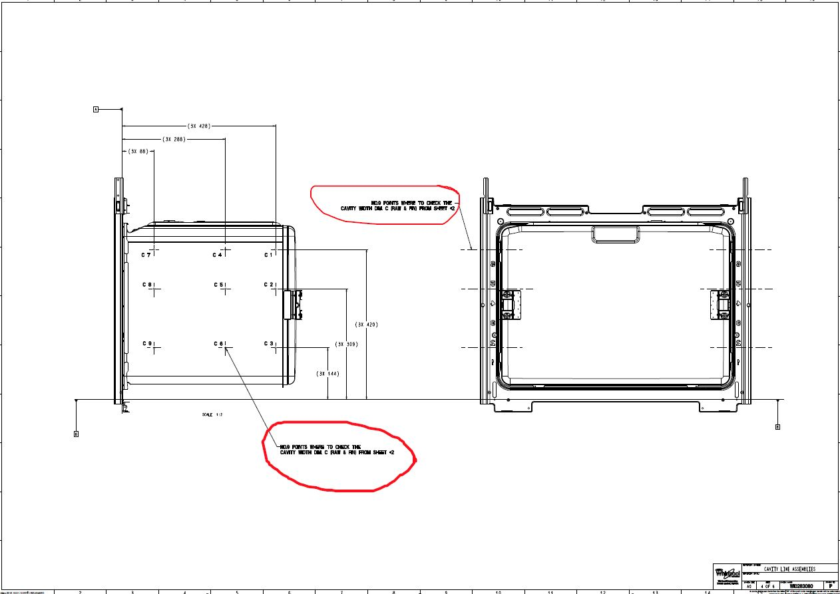
Concept Design: GD&T Markup
General Capability Notes
The Cavity widths are measured at locations near the C1 through C9 Callouts.
Notes:
Supplied By Chad Lako

Slide 5
Concept Design: Features
Whirlpool Datums
Datum A1
Datum A2
Datum A3
Datum B1
Datum B2
Datum C1
A3
The Visual Fixture Scheme
has been confirmed to match that of the Minerva CMM.
A2
A1
B2
B1
C1

Slide 6
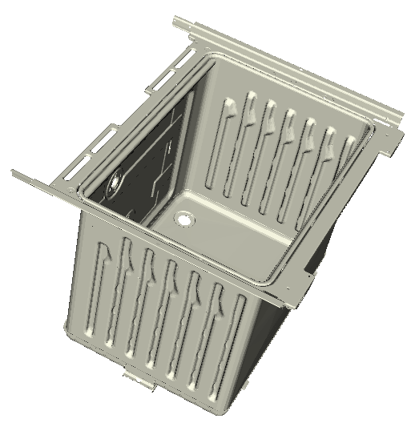
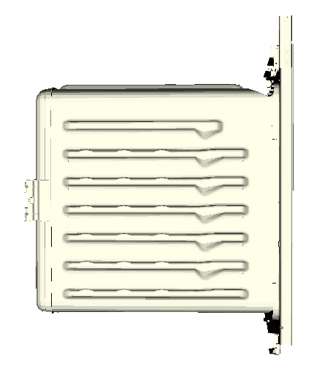
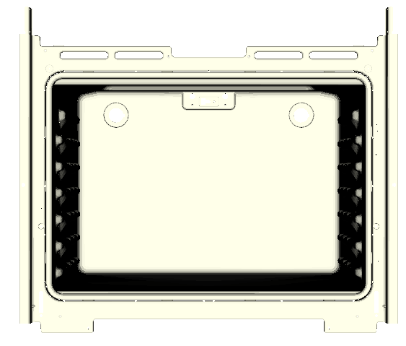
Concept Design: Measurement Locations
C1: distance between L1 and R1
C4: distance between L4 and R4
C7: distance between L7 and R7
R7
R4
R1
l
l
l
l
l
l
l
L7
l
l
R8
R5
R2
R9
R6
R3
l
l
L4
l
l
l
l
l
l
L1
l
L8
L5
L2
L9
L6
L3
C1
C4
C7
C2
C5
C8
L1/L4/L7
R1/R4/R7
C1/C4/C7
C3
C6
C9
L2/L5/L8
R2/R5/R8
Y
C2/C5/C8
L3/L6/L9
Y
R3/R6/R9
X
C3/C6/C9
Z

Slide 7
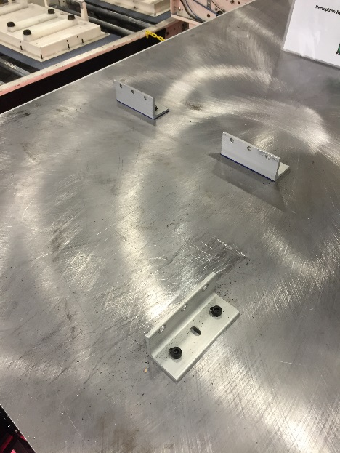
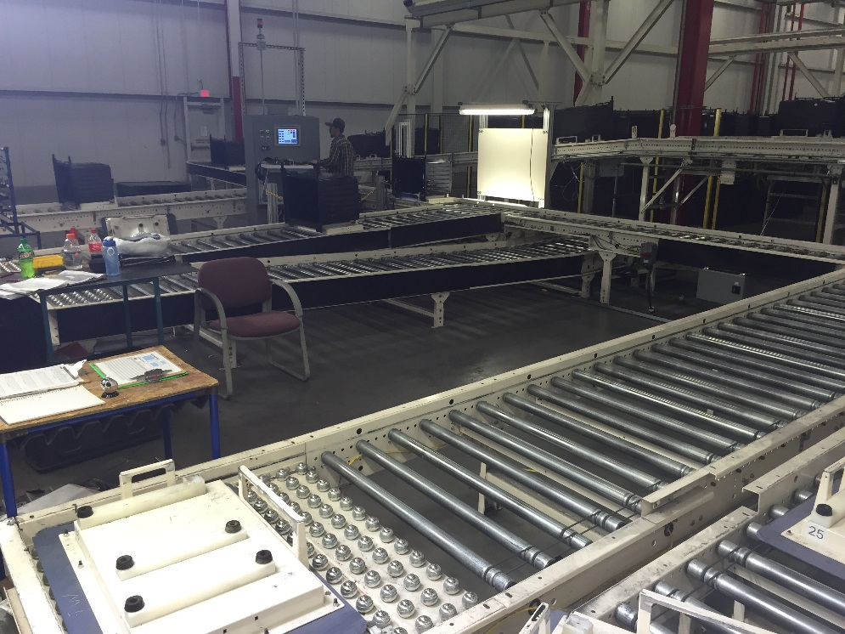
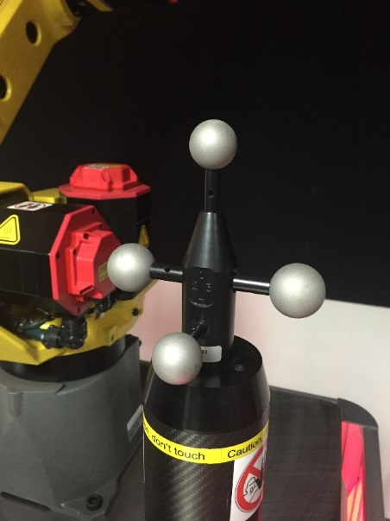
Physical Setup
Physical Setup
Fixed Locators handle all Parts
Area Scanner Volume Adjusted for Measurement Area
Risk Assessment Comducted – Sept. 22nd (Sundeep Jaganath)
Robot Paths & Pendant Display Tested
Fanuc M-10iA 12 Robot
DCS Robot
Cycle Times
Fiducial Measurement ~ 8 seconds
Error Proofing ~ 14 seconds
Part Measurement ~ 102 seconds
Robot Cycling Speed at 50%
of Robot Maximum Speed due to Risk Assessment Report

Slide 8
Video: Full Routine – Blue Cavity

Slide 9
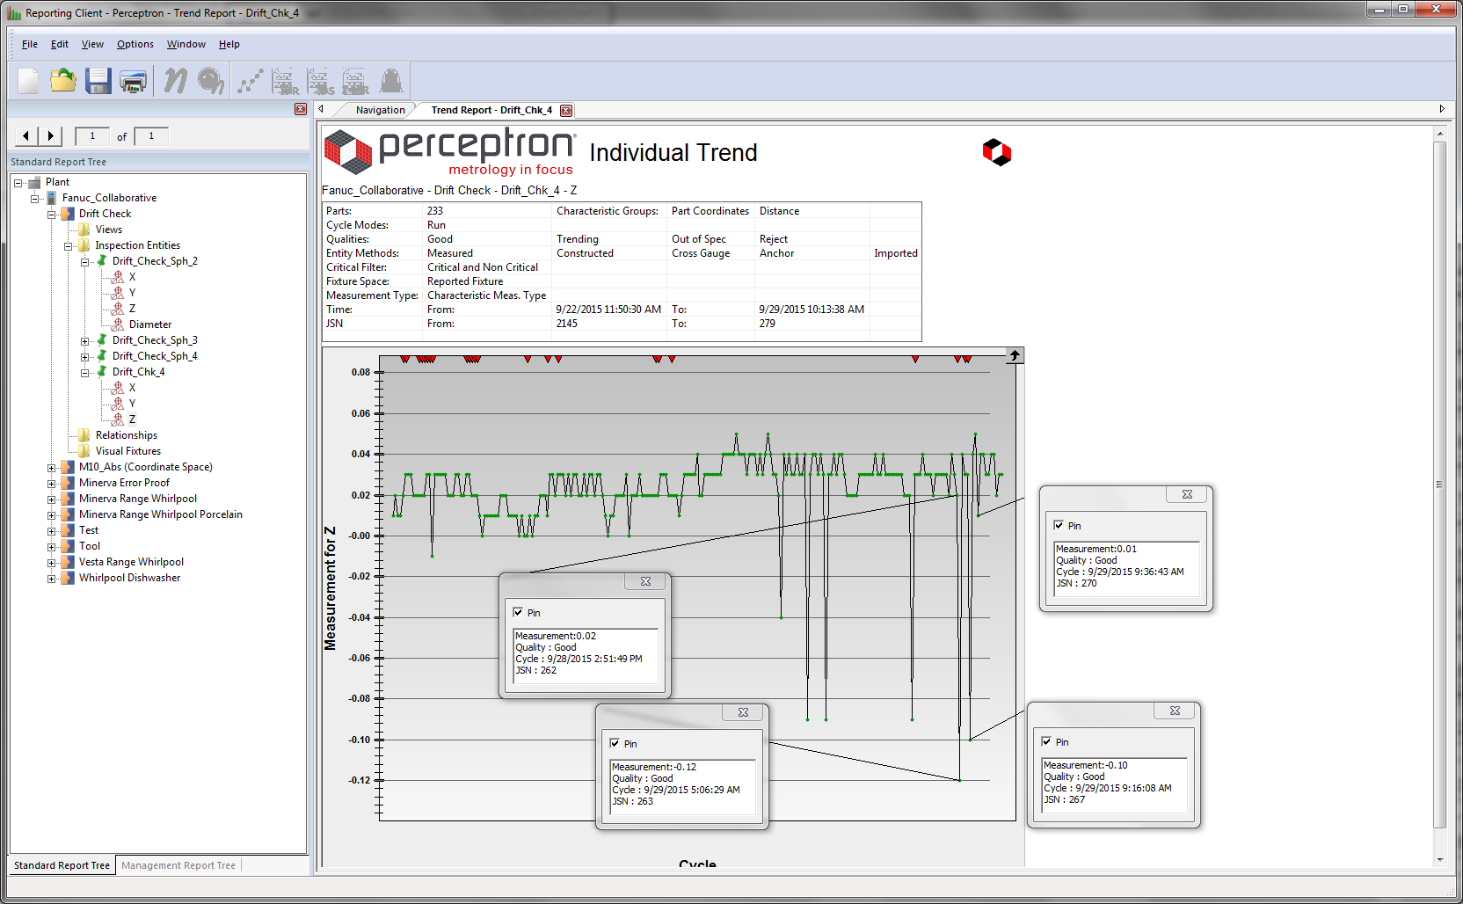
System Validation – Drift Check Results
Results
233 Drift Check Cycles from 9/22 to 9/29
Range of .17 mm
A couple flyers when system starts up
Initial analysis is Robot Temperature Compensation is not needed.

Slide 10
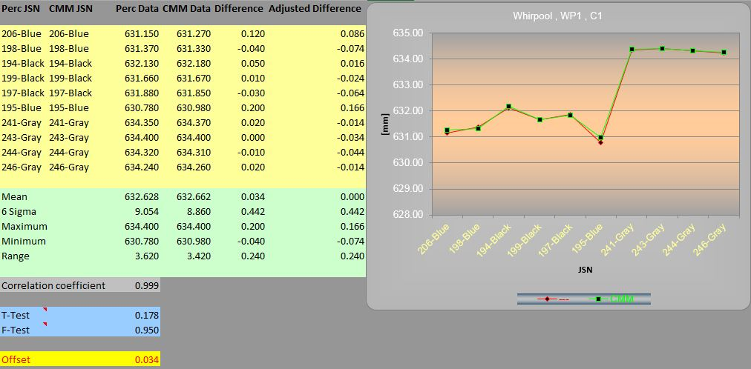
System Validation – Correlation Study
Results
10 Parts run through Perceptron Station and CMM
All 3 Porcelain Colors were Measured
Correlation is between width distance across cavity opening
2 CMM feature locations
2 Perceptron surface algorithms
Worst Correlation Coefficient at 0.956
Maximum Offset of only 0.128
285 Cavities have been measured as of 1:33PM 9/30.
Perc Axis | CMM-Axis | Perc Mean | CMM Mean | Correlation Coefficient | 6 Sigma | Calculated Offset
C1 | D1 | 632.628 | 632.662 | 0.999 | 0.442 | 0.034
C2 | D2 | 633.076 | 632.971 | 1.000 | 0.433 | -0.105
C3 | D3 | 633.059 | 633.112 | 0.997 | 0.421 | 0.053
C4 | D4 | 633.361 | 633.430 | 0.998 | 0.323 | 0.069
C5 | D5 | 633.872 | 633.897 | 0.999 | 0.583 | 0.025
C6 | D6 | 633.665 | 633.735 | 0.985 | 0.271 | 0.070
C7 | D7 | 633.657 | 633.639 | 0.999 | 0.559 | -0.018
C8 | D8 | 633.654 | 633.782 | 0.996 | 0.343 | 0.128
C9 | D9 | 634.084 | 634.177 | 0.956 | 0.375 | 0.093
C1

Slide 11
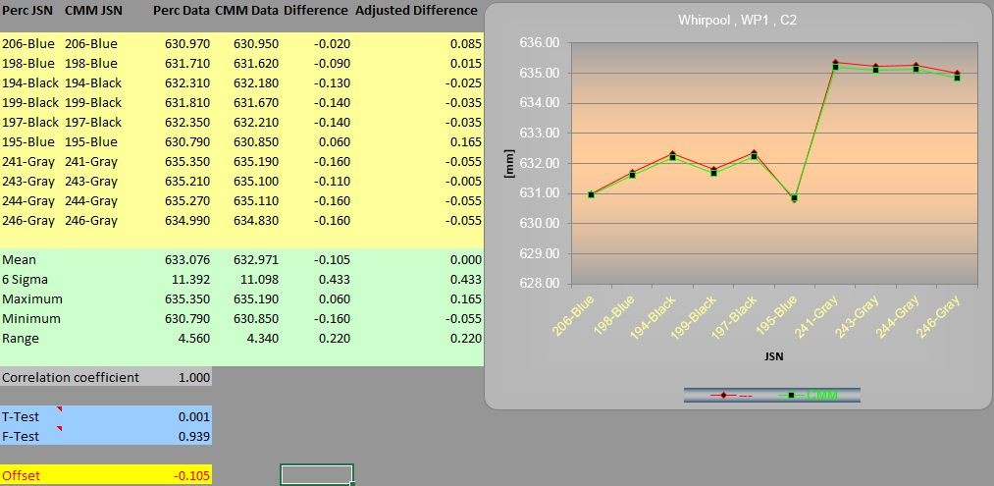
System Validation – Correlation Study
Results
10 Parts run through Perceptron Station and CMM
All 3 Porcelain Colors were Measured
Correlation is between width distance across cavity opening
2 CMM feature locations
2 Perceptron surface algorithms
Worst Correlation Coefficient at 0.956
Maximum Offset of only 0.128
Perc Axis | CMM-Axis | Perc Mean | CMM Mean | Correlation Coefficient | 6 Sigma | Calculated Offset
C1 | D1 | 632.628 | 632.662 | 0.999 | 0.442 | 0.034
C2 | D2 | 633.076 | 632.971 | 1.000 | 0.433 | -0.105
C3 | D3 | 633.059 | 633.112 | 0.997 | 0.421 | 0.053
C4 | D4 | 633.361 | 633.430 | 0.998 | 0.323 | 0.069
C5 | D5 | 633.872 | 633.897 | 0.999 | 0.583 | 0.025
C6 | D6 | 633.665 | 633.735 | 0.985 | 0.271 | 0.070
C7 | D7 | 633.657 | 633.639 | 0.999 | 0.559 | -0.018
C8 | D8 | 633.654 | 633.782 | 0.996 | 0.343 | 0.128
C9 | D9 | 634.084 | 634.177 | 0.956 | 0.375 | 0.093
C2

Slide 12
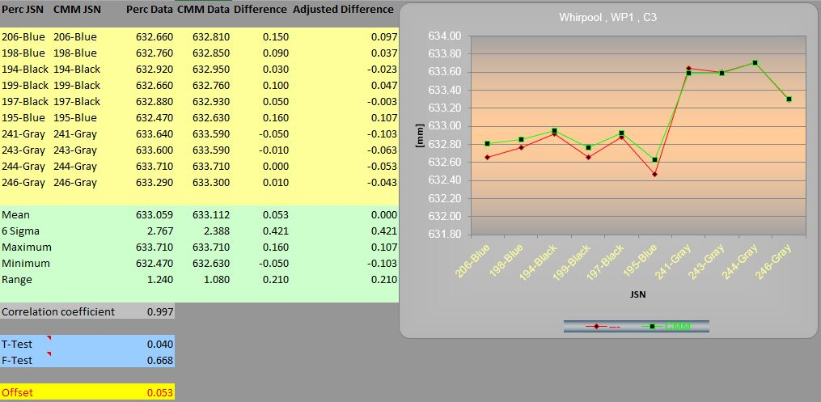
System Validation – Correlation Study
Results
10 Parts run through Perceptron Station and CMM
All 3 Porcelain Colors were Measured
Correlation is between width distance across cavity opening
2 CMM feature locations
2 Perceptron surface algorithms
Worst Correlation Coefficient at 0.956
Maximum Offset of only 0.128
Perc Axis | CMM-Axis | Perc Mean | CMM Mean | Correlation Coefficient | 6 Sigma | Calculated Offset
C1 | D1 | 632.628 | 632.662 | 0.999 | 0.442 | 0.034
C2 | D2 | 633.076 | 632.971 | 1.000 | 0.433 | -0.105
C3 | D3 | 633.059 | 633.112 | 0.997 | 0.421 | 0.053
C4 | D4 | 633.361 | 633.430 | 0.998 | 0.323 | 0.069
C5 | D5 | 633.872 | 633.897 | 0.999 | 0.583 | 0.025
C6 | D6 | 633.665 | 633.735 | 0.985 | 0.271 | 0.070
C7 | D7 | 633.657 | 633.639 | 0.999 | 0.559 | -0.018
C8 | D8 | 633.654 | 633.782 | 0.996 | 0.343 | 0.128
C9 | D9 | 634.084 | 634.177 | 0.956 | 0.375 | 0.093
C3

Slide 13
System Validation – Correlation Study
Results
10 Parts run through Perceptron Station and CMM
All 3 Porcelain Colors were Measured
Correlation is between width distance across cavity opening
2 CMM feature locations
2 Perceptron surface algorithms
Worst Correlation Coefficient at 0.956
Maximum Offset of only 0.128
Perc Axis | CMM-Axis | Perc Mean | CMM Mean | Correlation Coefficient | 6 Sigma | Calculated Offset
C1 | D1 | 632.628 | 632.662 | 0.999 | 0.442 | 0.034
C2 | D2 | 633.076 | 632.971 | 1.000 | 0.433 | -0.105
C3 | D3 | 633.059 | 633.112 | 0.997 | 0.421 | 0.053
C4 | D4 | 633.361 | 633.430 | 0.998 | 0.323 | 0.069
C5 | D5 | 633.872 | 633.897 | 0.999 | 0.583 | 0.025
C6 | D6 | 633.665 | 633.735 | 0.985 | 0.271 | 0.070
C7 | D7 | 633.657 | 633.639 | 0.999 | 0.559 | -0.018
C8 | D8 | 633.654 | 633.782 | 0.996 | 0.343 | 0.128
C9 | D9 | 634.084 | 634.177 | 0.956 | 0.375 | 0.093
C4

Slide 14
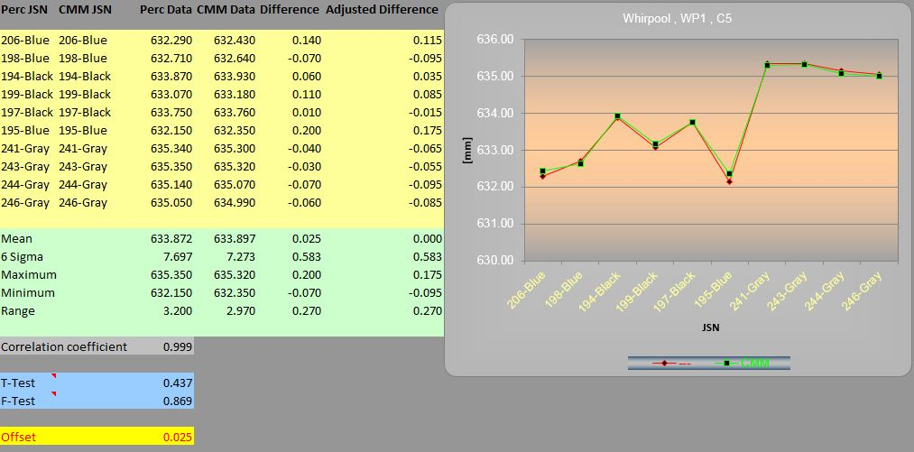
System Validation – Correlation Study
Results
10 Parts run through Perceptron Station and CMM
All 3 Porcelain Colors were Measured
Correlation is between width distance across cavity opening
2 CMM feature locations
2 Perceptron surface algorithms
Worst Correlation Coefficient at 0.956
Maximum Offset of only 0.128
Perc Axis | CMM-Axis | Perc Mean | CMM Mean | Correlation Coefficient | 6 Sigma | Calculated Offset
C1 | D1 | 632.628 | 632.662 | 0.999 | 0.442 | 0.034
C2 | D2 | 633.076 | 632.971 | 1.000 | 0.433 | -0.105
C3 | D3 | 633.059 | 633.112 | 0.997 | 0.421 | 0.053
C4 | D4 | 633.361 | 633.430 | 0.998 | 0.323 | 0.069
C5 | D5 | 633.872 | 633.897 | 0.999 | 0.583 | 0.025
C6 | D6 | 633.665 | 633.735 | 0.985 | 0.271 | 0.070
C7 | D7 | 633.657 | 633.639 | 0.999 | 0.559 | -0.018
C8 | D8 | 633.654 | 633.782 | 0.996 | 0.343 | 0.128
C9 | D9 | 634.084 | 634.177 | 0.956 | 0.375 | 0.093
C5

Slide 15
System Validation – Correlation Study
Results
10 Parts run through Perceptron Station and CMM
All 3 Porcelain Colors were Measured
Correlation is between width distance across cavity opening
2 CMM feature locations
2 Perceptron surface algorithms
Worst Correlation Coefficient at 0.956
Maximum Offset of only 0.128
Perc Axis | CMM-Axis | Perc Mean | CMM Mean | Correlation Coefficient | 6 Sigma | Calculated Offset
C1 | D1 | 632.628 | 632.662 | 0.999 | 0.442 | 0.034
C2 | D2 | 633.076 | 632.971 | 1.000 | 0.433 | -0.105
C3 | D3 | 633.059 | 633.112 | 0.997 | 0.421 | 0.053
C4 | D4 | 633.361 | 633.430 | 0.998 | 0.323 | 0.069
C5 | D5 | 633.872 | 633.897 | 0.999 | 0.583 | 0.025
C6 | D6 | 633.665 | 633.735 | 0.985 | 0.271 | 0.070
C7 | D7 | 633.657 | 633.639 | 0.999 | 0.559 | -0.018
C8 | D8 | 633.654 | 633.782 | 0.996 | 0.343 | 0.128
C9 | D9 | 634.084 | 634.177 | 0.956 | 0.375 | 0.093
C6

Slide 16
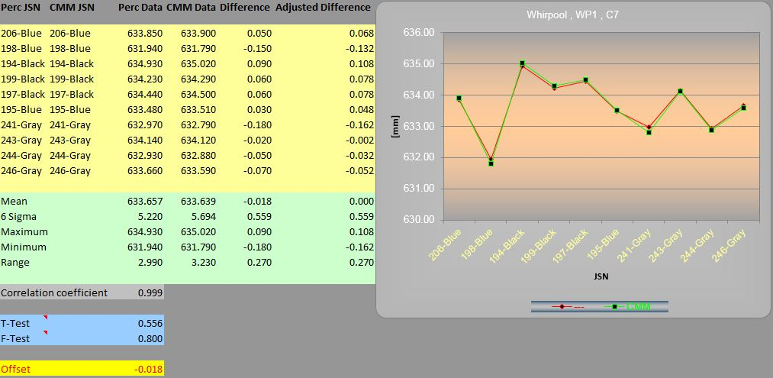
System Validation – Correlation Study
Results
10 Parts run through Perceptron Station and CMM
All 3 Porcelain Colors were Measured
Correlation is between width distance across cavity opening
2 CMM feature locations
2 Perceptron surface algorithms
Worst Correlation Coefficient at 0.956
Maximum Offset of only 0.128
Perc Axis | CMM-Axis | Perc Mean | CMM Mean | Correlation Coefficient | 6 Sigma | Calculated Offset
C1 | D1 | 632.628 | 632.662 | 0.999 | 0.442 | 0.034
C2 | D2 | 633.076 | 632.971 | 1.000 | 0.433 | -0.105
C3 | D3 | 633.059 | 633.112 | 0.997 | 0.421 | 0.053
C4 | D4 | 633.361 | 633.430 | 0.998 | 0.323 | 0.069
C5 | D5 | 633.872 | 633.897 | 0.999 | 0.583 | 0.025
C6 | D6 | 633.665 | 633.735 | 0.985 | 0.271 | 0.070
C7 | D7 | 633.657 | 633.639 | 0.999 | 0.559 | -0.018
C8 | D8 | 633.654 | 633.782 | 0.996 | 0.343 | 0.128
C9 | D9 | 634.084 | 634.177 | 0.956 | 0.375 | 0.093
C7

Slide 17
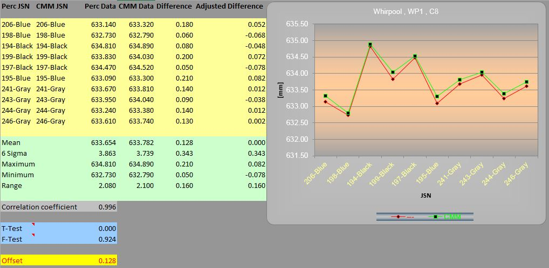
System Validation – Correlation Study
Results
10 Parts run through Perceptron Station and CMM
All 3 Porcelain Colors were Measured
Correlation is between width distance across cavity opening
2 CMM feature locations
2 Perceptron surface algorithms
Worst Correlation Coefficient at 0.956
Maximum Offset of only 0.128
Perc Axis | CMM-Axis | Perc Mean | CMM Mean | Correlation Coefficient | 6 Sigma | Calculated Offset
C1 | D1 | 632.628 | 632.662 | 0.999 | 0.442 | 0.034
C2 | D2 | 633.076 | 632.971 | 1.000 | 0.433 | -0.105
C3 | D3 | 633.059 | 633.112 | 0.997 | 0.421 | 0.053
C4 | D4 | 633.361 | 633.430 | 0.998 | 0.323 | 0.069
C5 | D5 | 633.872 | 633.897 | 0.999 | 0.583 | 0.025
C6 | D6 | 633.665 | 633.735 | 0.985 | 0.271 | 0.070
C7 | D7 | 633.657 | 633.639 | 0.999 | 0.559 | -0.018
C8 | D8 | 633.654 | 633.782 | 0.996 | 0.343 | 0.128
C9 | D9 | 634.084 | 634.177 | 0.956 | 0.375 | 0.093
C8

Slide 18
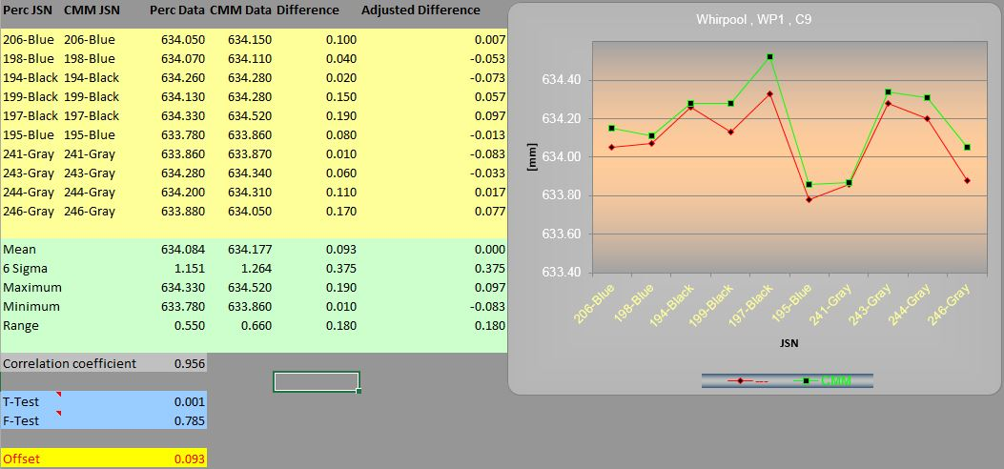
System Validation – Correlation Study
Results
10 Parts run through Perceptron Station and CMM
All 3 Porcelain Colors were Measured
Correlation is between width distance across cavity opening
2 CMM feature locations
2 Perceptron surface algorithms
Worst Correlation Coefficient at 0.956
Maximum Offset of only 0.128
Perc Axis | CMM-Axis | Perc Mean | CMM Mean | Correlation Coefficient | 6 Sigma | Calculated Offset
C1 | D1 | 632.628 | 632.662 | 0.999 | 0.442 | 0.034
C2 | D2 | 633.076 | 632.971 | 1.000 | 0.433 | -0.105
C3 | D3 | 633.059 | 633.112 | 0.997 | 0.421 | 0.053
C4 | D4 | 633.361 | 633.430 | 0.998 | 0.323 | 0.069
C5 | D5 | 633.872 | 633.897 | 0.999 | 0.583 | 0.025
C6 | D6 | 633.665 | 633.735 | 0.985 | 0.271 | 0.070
C7 | D7 | 633.657 | 633.639 | 0.999 | 0.559 | -0.018
C8 | D8 | 633.654 | 633.782 | 0.996 | 0.343 | 0.128
C9 | D9 | 634.084 | 634.177 | 0.956 | 0.375 | 0.093
C9

Slide 19
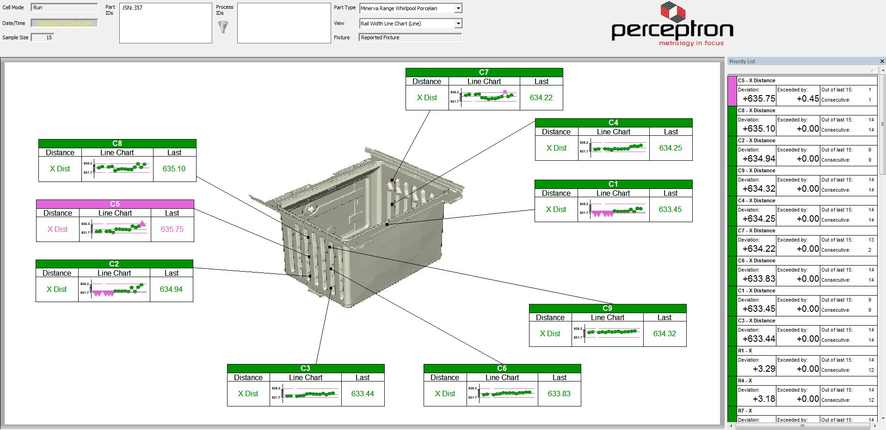
System Validation – Measurement Monitor Display
Line Display – Cavity Widths

Slide 20
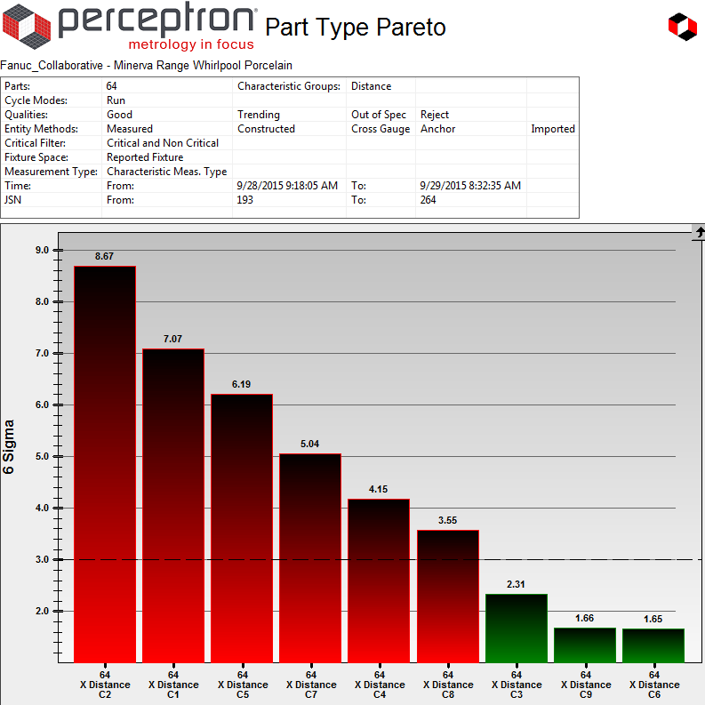
System Validation – Variation Reduction Analysis
Distance 6-sigma variation Pareto chart based on Data collected on 9/28/2015
l
l
l
l
l
l
l
l
l
l
l
l
l
l
l
l
l
C7
C4
C1
l
C1
C4
C7
C8
C5
C2
C9
C6
C3
C2
C5
C8
C3
C6
C9

Slide 21
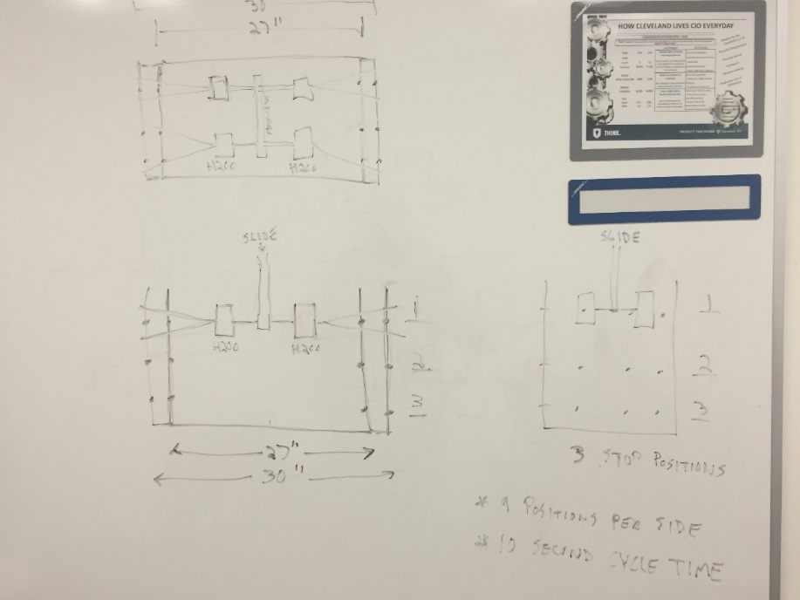
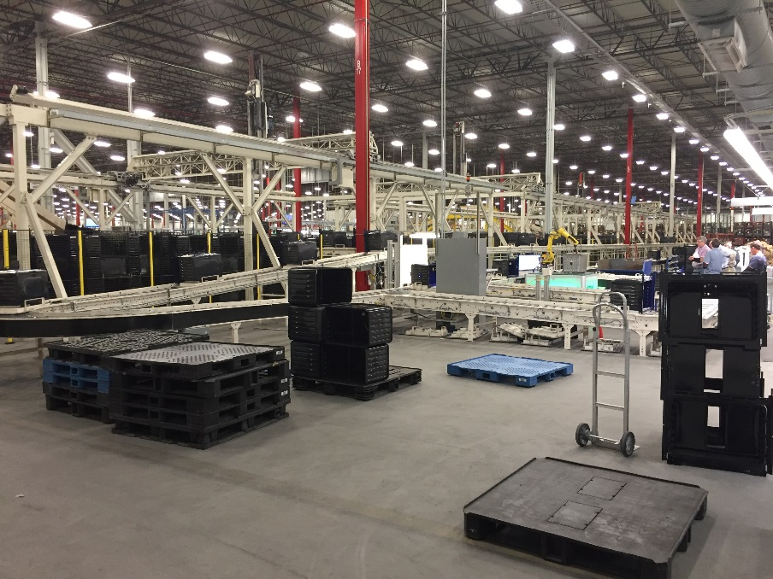
Next Steps
General Notes:
100% In-Line Measurement
10 Second Cycle Time
Model Mix Needs to be Identified
Minerva, Urso, Scott Line
Determines number of Required Stations
Possibility of Individual Part Identification (Barcode Scanner) in Future
Proposed Solution:
100% In-Line Automated Solution
1 or 2 Stations depending on Model Mix
Servo Slide Solution(s)
4 Sensors
3 Positions
Located after Current Sensing Station
Sensing Station Requirements
Determine part on carrier
Confirm parts are located correctly on carriers
Information to be sent to PLC
Repair Loop to be moved after last Perceptron Station
Provide a list of Preferred Local Integrators

